Slide 1
Machine learning to unveil the fluid structure interaction of air-backed impact
Dynamical Systems Laboratory
New York University Tandon School of Engineering, Brooklyn, NY
Simon Carrillo Segura (PhD) | Akhilesh Kapse
18 June 2021

Slide 2
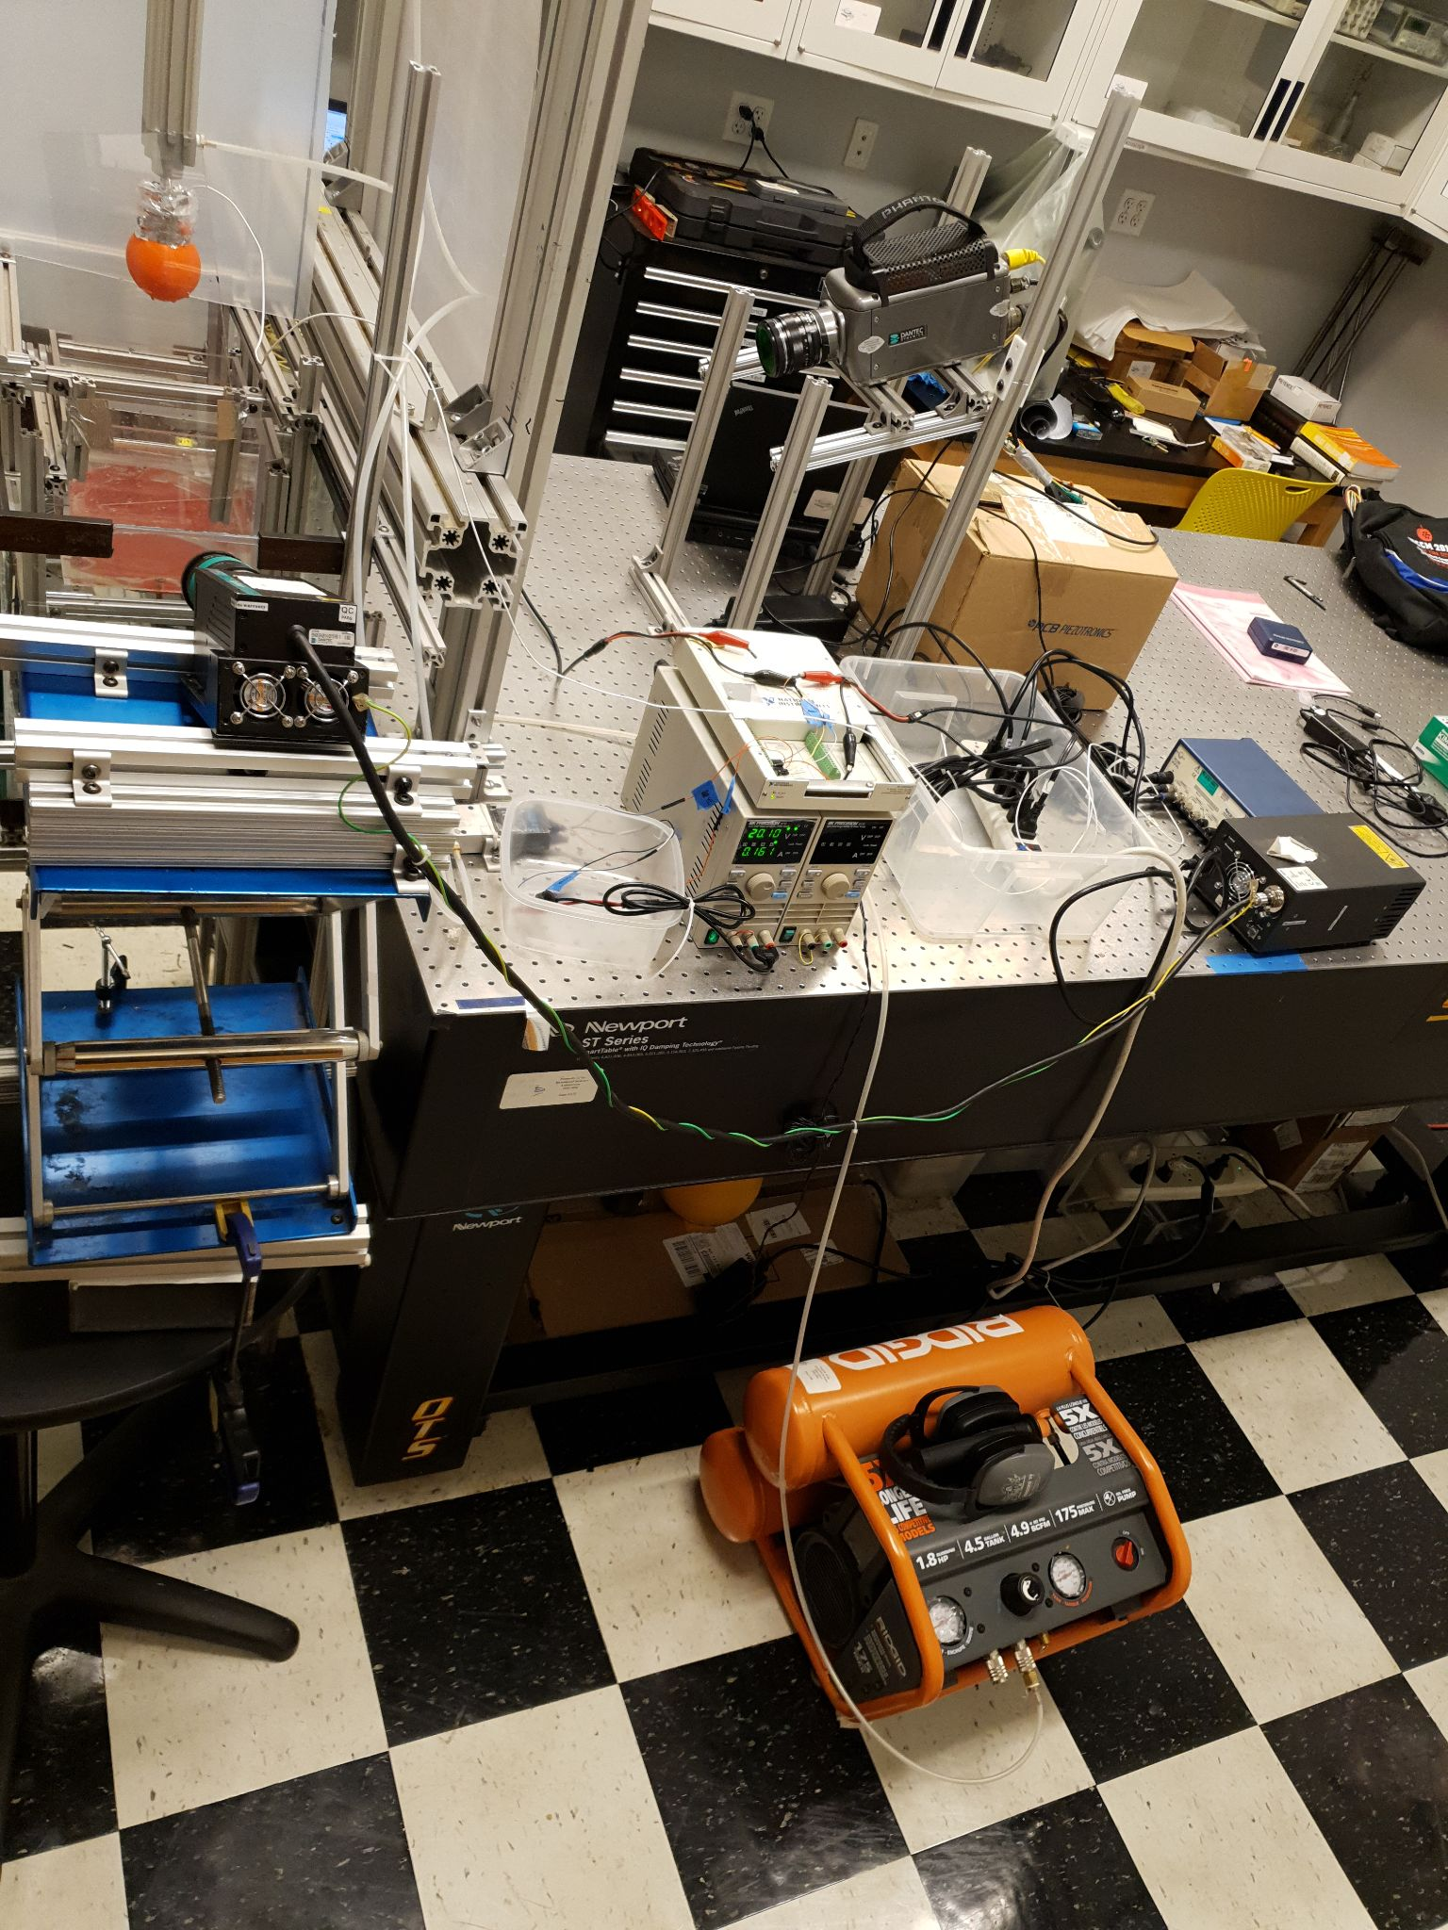
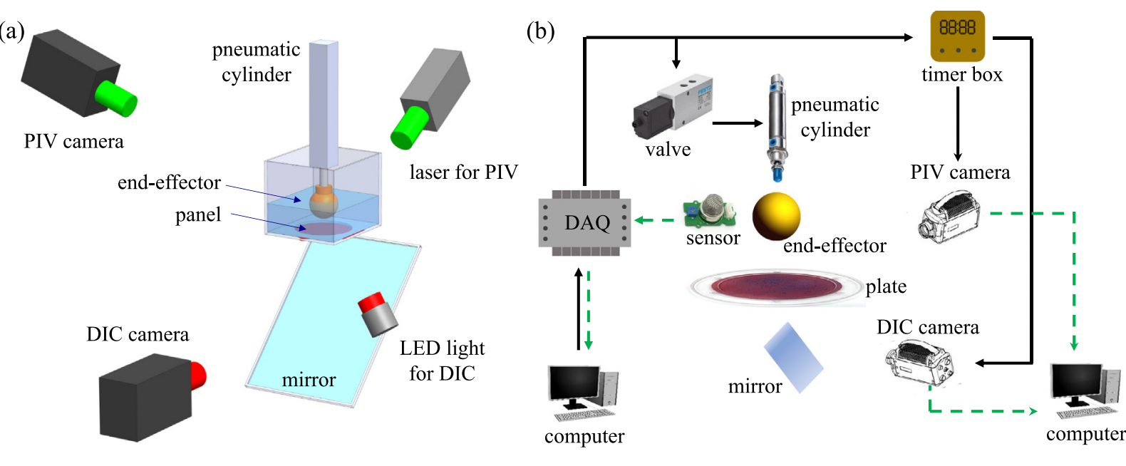
Experimental Setup
Actual Setup

Slide 3
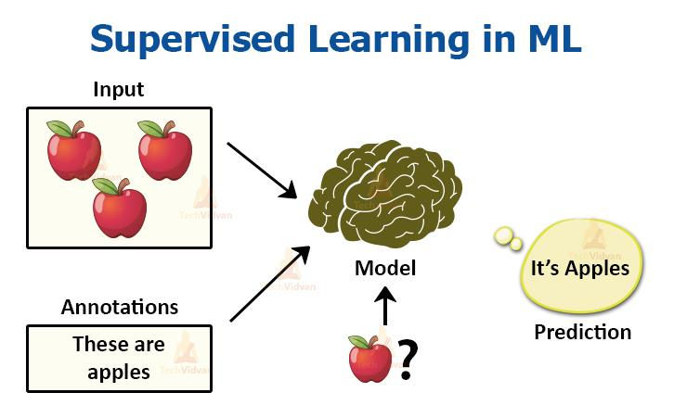
Supervised learning
Supervised learning (SL) is the machine learning task of learning a function that maps an input to an output based on example input-output pairs.
A supervised learning algorithm analyzes the training data and produces an inferred function, which can be used for mapping new examples.

Slide 4
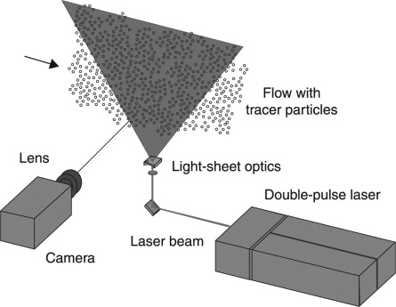
Input-Data
High-speed camera in PIV (Particle Image Velocimetry) camera for fluid motion analysis.
Data recorded by means of a high resolution CCD sensor array.
Getting raw-data as .tif file (converted to .jpg for processing)

Slide 5
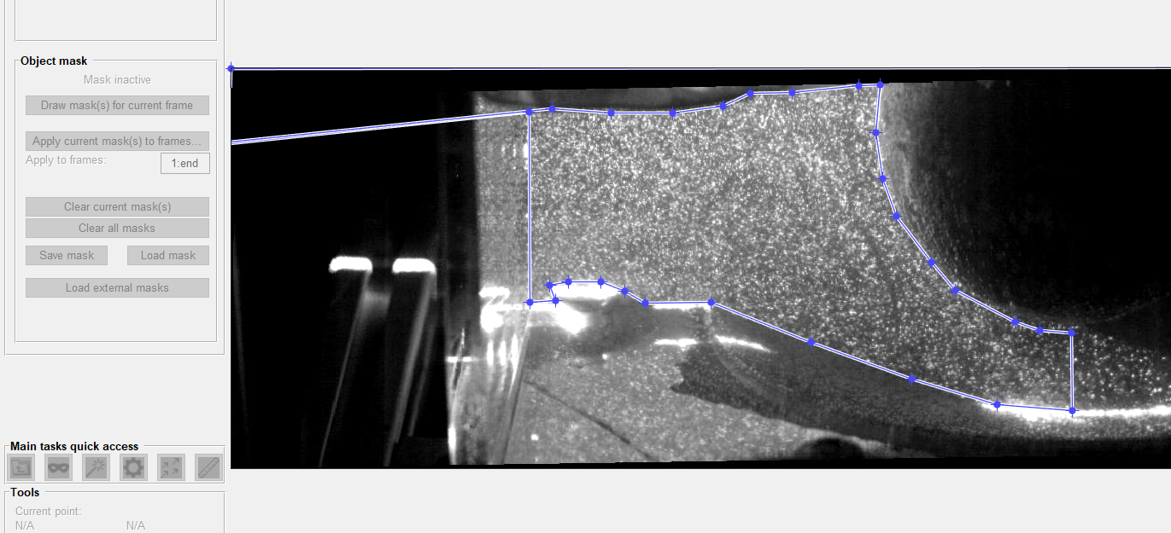
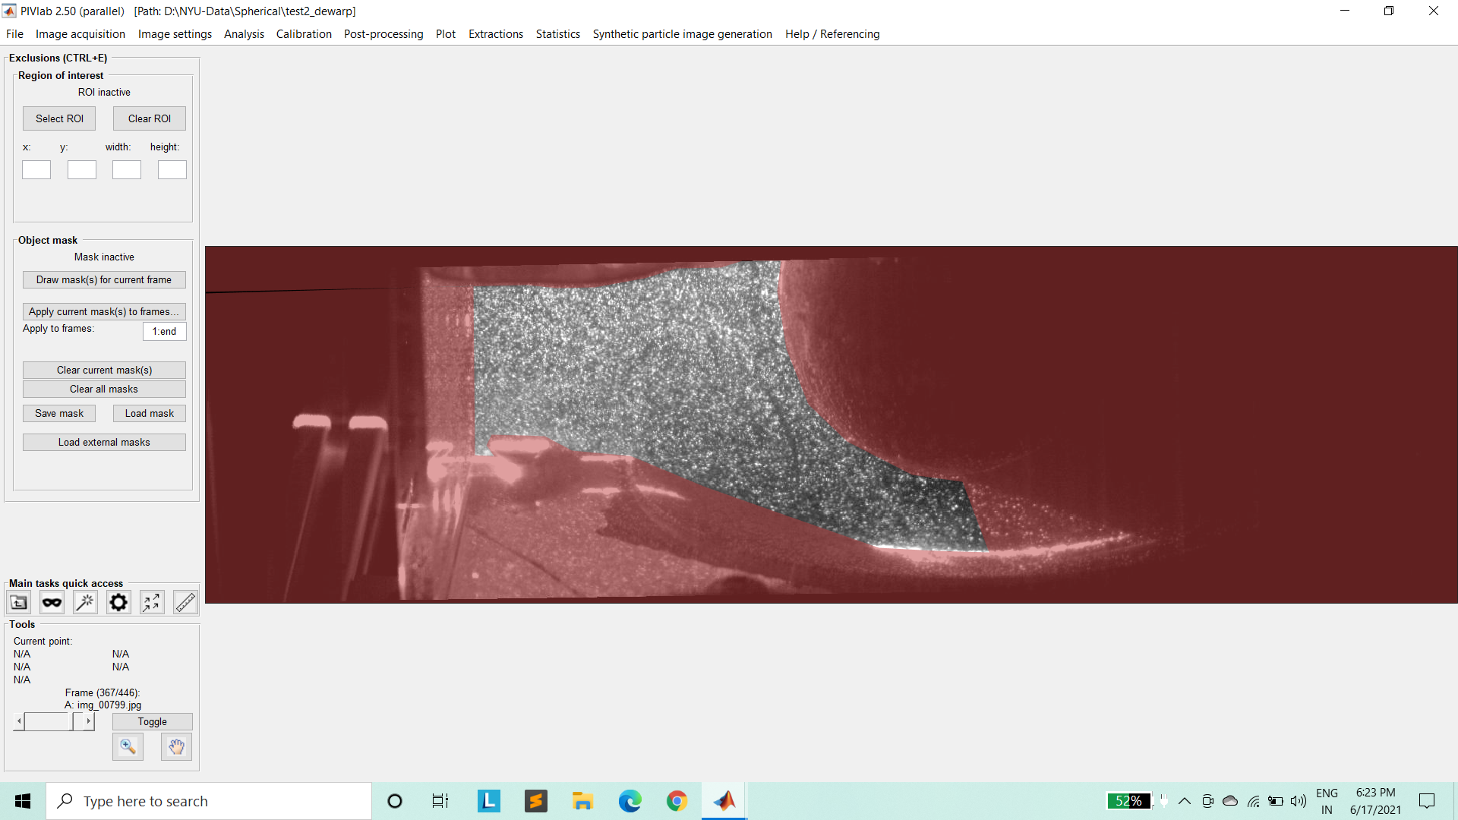
MATLAB (PIV-LAB)
Manual masking of around ~450 PIV images for spherical impactor.
Saving coordinates and whole session for further analysis in .mat file.
Extracting this file for Binary Mask via Python and Matlab Code.

Slide 6



Fixing-Errors
Unable to mask brighten screw and upper edge (Python code).
2. Unable to mask water surface disturbance (Matlab code).
3. Final Maks
( Matrix Multiply + Contour detection)

Slide 7
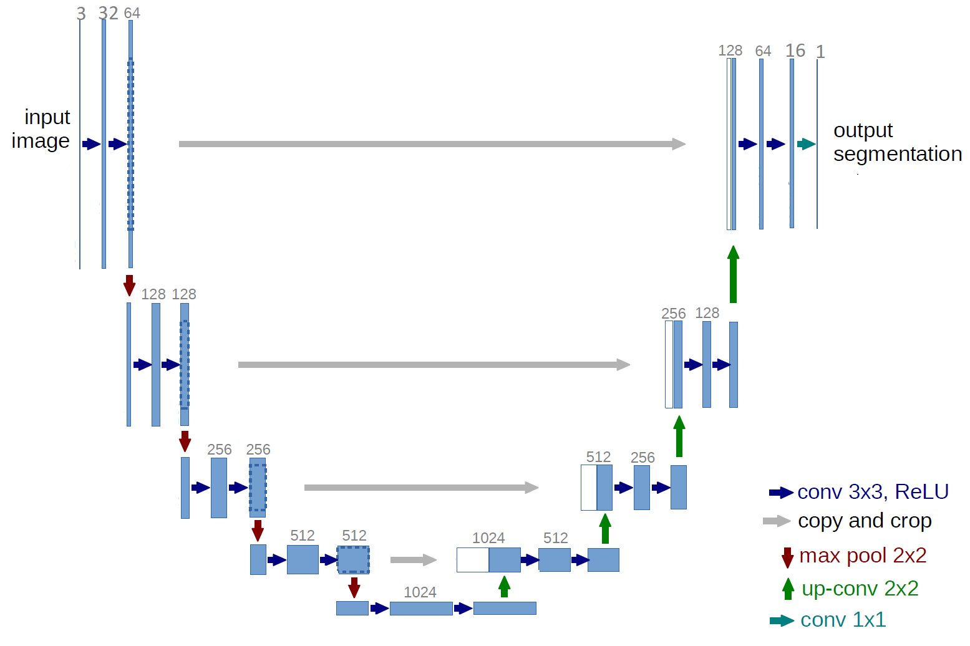
Baseline- Unet Performance
Unet Model

Slide 8
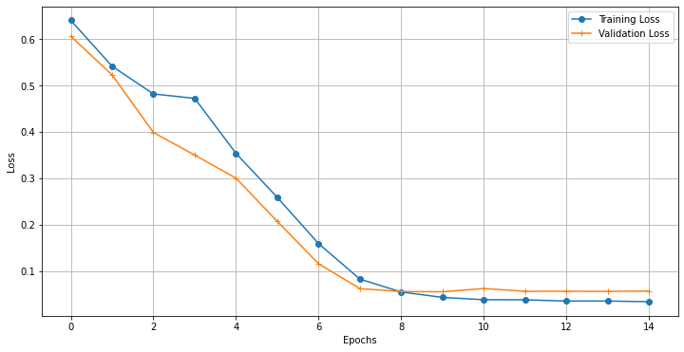
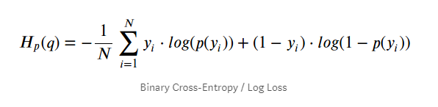
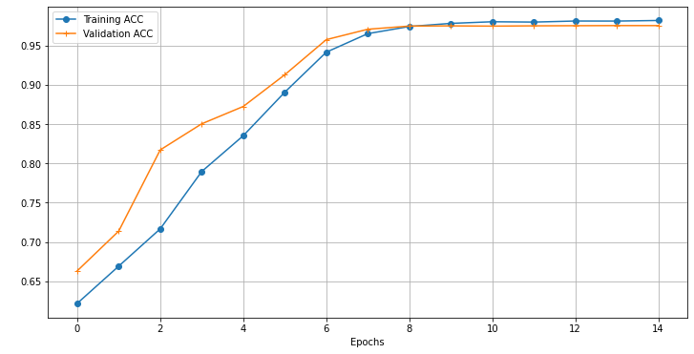
Baseline- Unet Performance
Loss for masking= BCE
Accuracy for evaluation
Acc

Slide 9
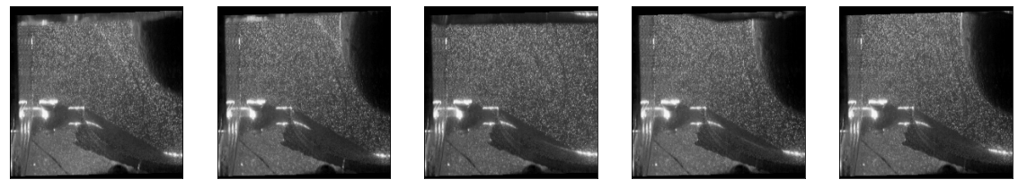
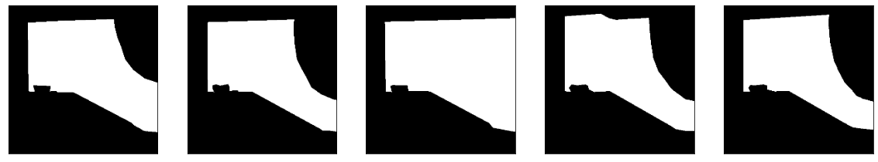
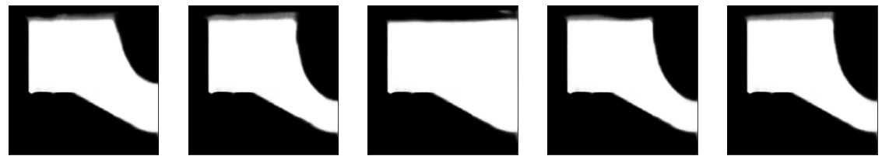
Baseline- Unet Performance
Actual Image
Ground Truth
Predicted

Slide 10
Thank You
Future work-
Hyperparameter Tuning
Addition of cylindrical experiment data
MATLAB Velocity analysis

